Slide 1
Probability and statistics
Course Name

Slide 2
Why do we need probability and statistics ?
Real world phenomenon are filled with uncertainly and randomness.
Data is often:
Incomplete
Buggy/Incorrectly recorded
Biased
How do we deal with this uncertainty in the real phenomenon.

Slide 3
Data analytics
Data Analytics is used to get conclusions by processing the raw data. It is helpful in various businesses as it helps the company to make decisions based on the conclusions from the data. Basically, data analytics helps to convert a Large number of figures in the form of data into Plain English i.e., conclusions which are further helpful in making in-depth decisions.

Slide 4
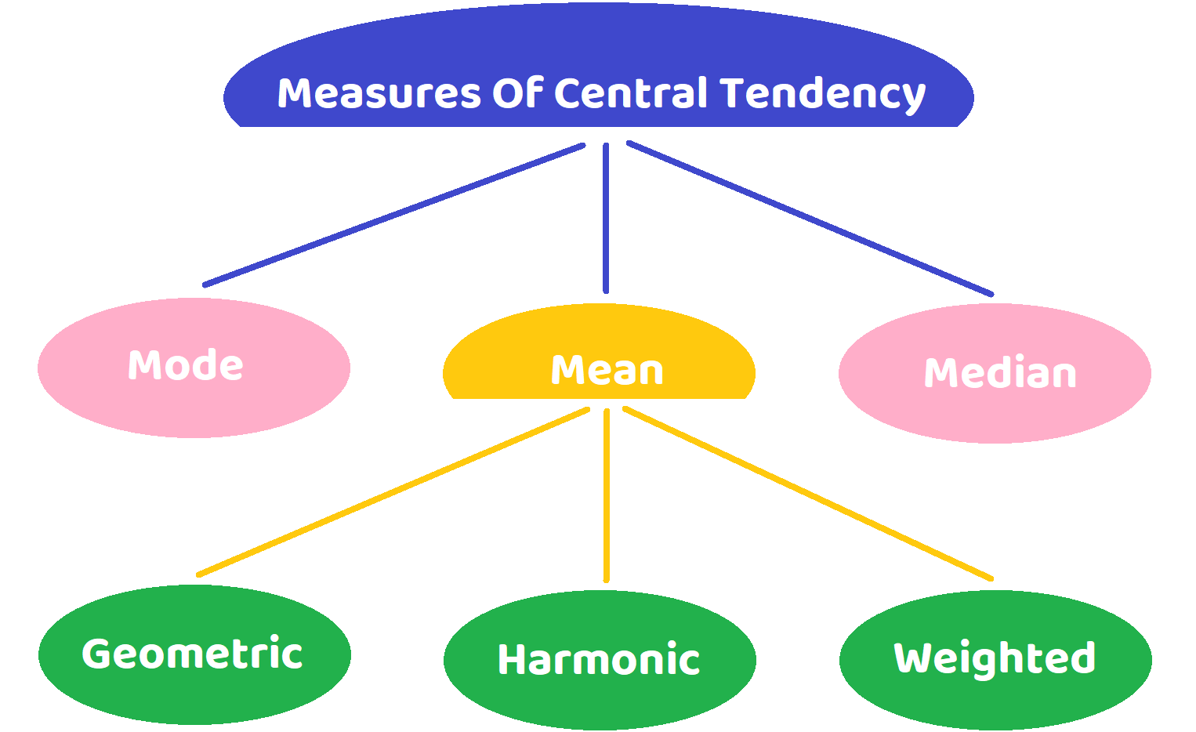
Measures of central tendency
A measure of central tendency (also referred to as measures of centre or central location) is a summary measure that attempts to describe a whole set of data with a single value that represents the middle or centre of its distribution.

Slide 5
Measures of central tendency
Mean
The mean is the sum of the value of each observation in a dataset divided by the number of observations. This is also known as the arithmetic average.
Median
The median is the middle value in distribution when the values are arranged in ascending or descending order.The median divides the distribution in half (there are 50% of observations on either side of the median value).In a distribution with an odd number of observations, the median value is the middle value. When the distribution has an even number of observations, the median value is the mean of the two middle values.
Mode
The mode is the most commonly occurring value in a distribution.

Slide 6
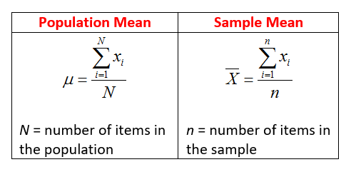
Mean
The population mean is indicated by the Greek symbol µ (pronounced ‘mu’).
When the mean is calculated on a distribution from a sample it is indicated by the symbol x̅ (pronounced X-bar).

Slide 7
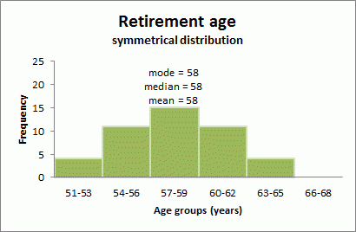
Symmetrical distributions
When a distribution is symmetrical, the mode, median and mean are all in the middle of the distribution. The following graph shows a larger retirement age dataset with a distribution which is symmetrical. The mode, median and mean all equal 58 years.

Slide 8
Skewed distributions
When a distribution is skewed the mode remains the most commonly occurring value, the median remains the middle value in the distribution, but the mean is generally ‘pulled’ in the direction of the tails. In a skewed distribution, the median is often a preferred measure of central tendency, as the mean is not usually in the middle of the distribution.

Slide 9
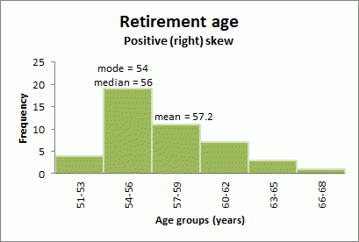
Positive (right) skew
A distribution is said to be positively or right skewed when the tail on the right side of the distribution is longer than the left side. In a positively skewed distribution it is common for the mean to be ‘pulled’ toward the right tail of the distribution. Although there are exceptions to this rule, generally, most of the values, including the median value, tend to be less than the mean value.

Slide 10
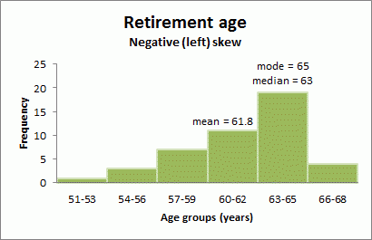
Negative (left) skew
A distribution is said to be negatively or left skewed when the tail on the left side of the distribution is longer than the right side. In a negatively skewed distribution, it is common for the mean to be ‘pulled’ toward the left tail of the distribution. Although there are exceptions to this rule, generally, most of the values, including the median value, tend to be greater than the mean value.

Slide 11
Types of mean
Arithmetic Mean
Weighted Mean
Geometric Mean
Harmonic Mean

Slide 12
Arithmetic Mean
Arithmetic mean is often referred to as the mean or arithmetic average, which is calculated by adding all the numbers in a given data set and then dividing it by the total number of items within that set.
For example, in the early morning while reading a newspaper, have you observed the daily temperature reports. Well, the temperature varies all day still how a single temperature can indicate the condition for the entire day? Or when you get your scorecard in exams, instead of analyzing your performance based on the percentage in all subjects, the performance is based upon the aggregate percentage.

Slide 13



Mean for ungrouped data

Slide 14
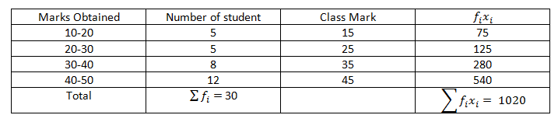

Example
In a class of 30 students, marks obtained by students in mathematics out of 50 is tabulated below. Calculate the mean of the data.

Slide 15
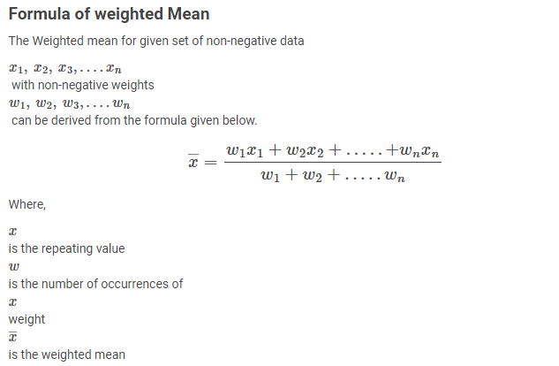
Weighted Mean
Weighted Mean is an average computed by giving different weights to some of the individual values. If all the weights are equal, then the weighted mean is the same as the arithmetic mean.

Slide 16
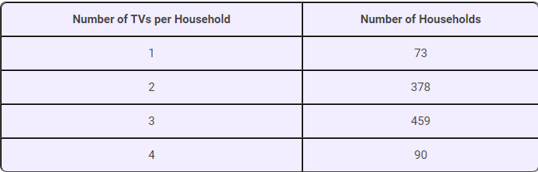
Example
Suppose that a marketing firm conducts a survey of 1,000 households to determine the average number of TVs each household owns. The data show a large number of households with two or three TVs and a smaller number with one or four. Every household in the sample has at least one TV and no household has more than four. Find the mean number of TVs per household.

Slide 17
Weighted Mean:Example
Jay is a rice merchant who sells various types of rice in Maharashtra. Some rice grades are of higher quality and sold at a higher price. He wants you to calculate the weighted mean from the following data:
Grade of A | Units Sold | Unit Price
A | 100 | 60
B | 60 | 50
C | 50 | 40
D | 10 | 30

Slide 18
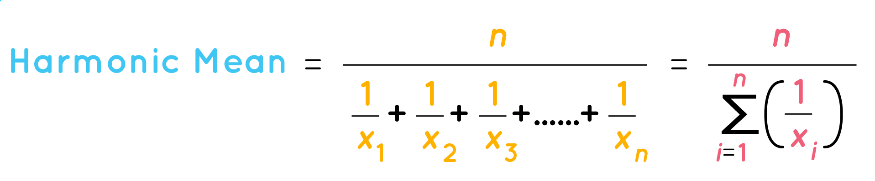
Harmonic Mean
Harmonic mean is a type of numerical average that is usually used in situations when the average rate or rate of change needs to be calculated.
When the values are expressed in rates we use harmonic mean.
The harmonic mean is a measure of central tendency.
The harmonic mean is a type of Pythagorean mean. To find it, we divide the number of terms in a data series by the sum of all the reciprocal terms.
Formula:

Slide 19
Mean for two numbers
We have 2 numbers a and b.
n = 2
According to definition
AM = (a + b) / 2.
HM = 2ab / (a + b) or (ab) [2 / (a + b)]
GM = √(ab).

Slide 20
Examples
Calculate the harmonic mean if the arithmetic mean = 9.4, and geometric mean = 8.1649.
Solution:
We know that GM2 = HM × AM.
Thus, HM = GM2 / AM = 8.16492/ 9.4 = 7.09.
Answer: Harmonic mean = 7.09.

Slide 21
Example
Suppose we have a sequence given by 1, 3, 5, 7. The difference between each term is 2.
To find the harmonic mean, we take the reciprocal of these terms.
This is given as 1, 1/3, 1/5, 1/7 (the sequence forms a harmonic progression).
Next, we divide the total number of terms (4) by the sum of the terms
(1 + 1/3 + 1/5 + 1/7).
Thus, the harmonic mean = 4 / (1 + 1/3 + 1/5 + 1/7) = 2.3864.

Slide 22
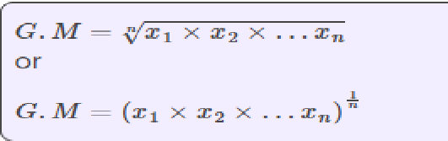
Geometric Mean
Geometric Mean involves finding the product of all observations or values and calculating the nth root of the product of the observations. The value of n indicates the total number of observations.
Formula:

Slide 23
Sample Mean Example
A preschool authority wants to know the approximate average weight of students. Out of 360 students, 40 students are randomly selected for weighing.

Slide 24
No.of Students | Weight(Kg) | No.of students x Weight(Kg)
2 | 14 | 28
3 | 14.5 | 43.5
1 | 15 | 15
1 | 15.5 | 15.5
3 | 16 | 48
2 | 16.5 | 33
4 | 17 | 68
3 | 17.5 | 52.5
2 | 18 | 36
5 | 18.5 | 92.5
1 | 19 | 19
4 | 19.5 | 78
3 | 20 | 60
1 | 20.5 | 20.5
5 | 21 | 105
40 |  | 714.5
Clearly, ∑x_{i} = 714.5 Kgs
And, n = 40
Now let us apply the values to the formula:
x̄ =∑x_{i} /n
x̄ = 714.5 / 40 = 17.86 Kgs
Hence, the approximate average weight of preschool students is 17.86 kgs.

Slide 25
Population Mean
Let us assume that the prices of ABC stock at the end of every trading day for 20 days of a month are as follows:
$15.15, $15.42,$14.91, $14.78,
$15.12, $15.56, $15.36, $15.13,
$15.31, $14.79, $15.11, $15.31,
$15.27, $14.49, $14.77, $14.35,
$14.64, $15.21, $15.38, and $15.44.
Solution:
μ=∑X / N
μ = ($15.15 + $15.42 + $14.91 + $14.78, $15.12 + $15.56, $15.36 + $15.13 + $15.31 + $14.79 + $15.11 + $15.31 + $15.27 + $14.49 + $14.77 + $14.35 + $14.64 + $15.21 + $15.38 + $15.44) / 20 = 301.5 / 20 = $15.07
Thus, the population mean of ABC stock prices is $15.07.

Slide 26
Summary
Arithmetic mean is used when the data values have the same units.
The geometric mean is used when the data set values have differing units.
When the values are expressed in rates we use harmonic mean.
Also, HM ≤ GM ≤ AM.
The relation between AM, GM and HM is GM^2 = AM × HM.
It can also be written as GM = √[ AM × HM]
Harmonic mean sees widespread use in geometry and music. It is also used to calculate the average of ratios as it equalizes all the data points.
The sample mean sometimes lacks accuracy due to sampling errors and may not fairly depict the population mean. Even so, it is not always possible to determine the population mean when the population size is too large.

